Slide 1

Unit 3
Complete the Past Paper section on the unit ‘Religious Expression’’ then we are going to peer assess in red and save as!

Slide 2
Starter
Remember the exam in on 31st May and you will have an RE booster session on that morning. RE revision is also wed/thurs this week to go through anything you are unsure about!
HOWEVER it is also up to you to begin revision and reading through the resources you have been given.
But for today since we have already looked at ‘Conflict’ and ‘Medicine’ a bit its time to move on to ‘Expression’ some more and if time allows ‘Authority and State’

Slide 3





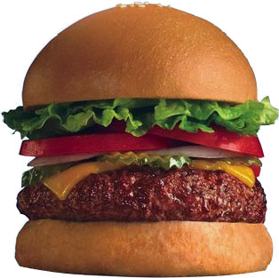
Religious Symbols
Religious Buildings
Worship/Clothing
Religion in the media
Pilgrimage
POINT
EXAMPLE
EXPLAIN

Slide 4


A*
A
To apply religious teachings/vocabulary effectively to improve upon my exam answers
State two rules of conduct expected in a place of worship (2) You must
Explain why some religious believers go on pilgrimage (4)
‘Television is not for programs about religion’ Give two reasons why a believer would agree or disagree (4)
Explain from two different religious traditions how a religious building can help believers express faith (6)
‘Pilgrimages are unnecessary’ Do you agree? (8)
B
To communicate my opinion clearly and use some religious vocabulary in my answers
C
To know key terms for the unit and give my personal opinion about important issues
Notes:
Make a new slide for your answers

Slide 5

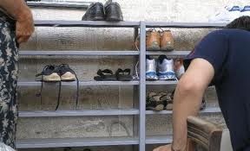
A*
A
To apply religious teachings/vocabulary effectively to improve upon my exam answers
State two rules of conducted expected in a place of worship (2) You must dress appropriately for your religion, you must not swear. Remove shoes before entering
1 mark. Develop your explanations.
B
To communicate my opinion clearly and use some religious vocabulary in my answers
C
To know key terms for the unit and give my personal opinion about important issues
Notes:
Make a new slide for your answers

Slide 6

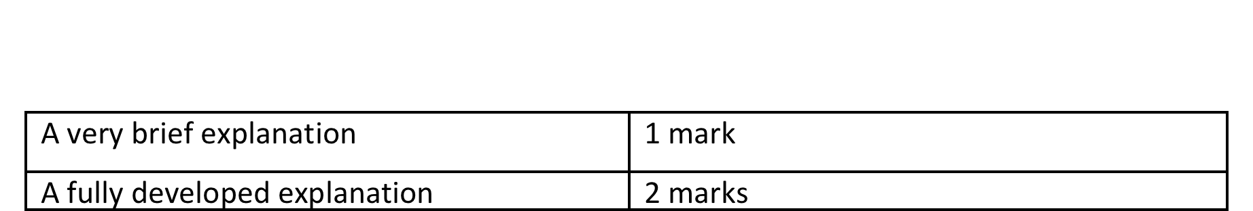
Marking A Questions
Give your mark using this criteria
Notes:
Make a new slide for your answers

Slide 7
A*
A
To apply religious teachings/vocabulary effectively to improve upon my exam answers
b) Explain why some religious believers go on pilgrimage (4).
Muslims believe they must go on a pilgrimage as it is one of the five pillars, this then makes them at one with themselves. When going on a pilgrimage they can experience Allah.
2 = you need more explanation;
B
To communicate my opinion clearly and use some religious vocabulary in my answers
C
To know key terms for the unit and give my personal opinion about important issues
Notes:
Make a new slide for your answers

Slide 8

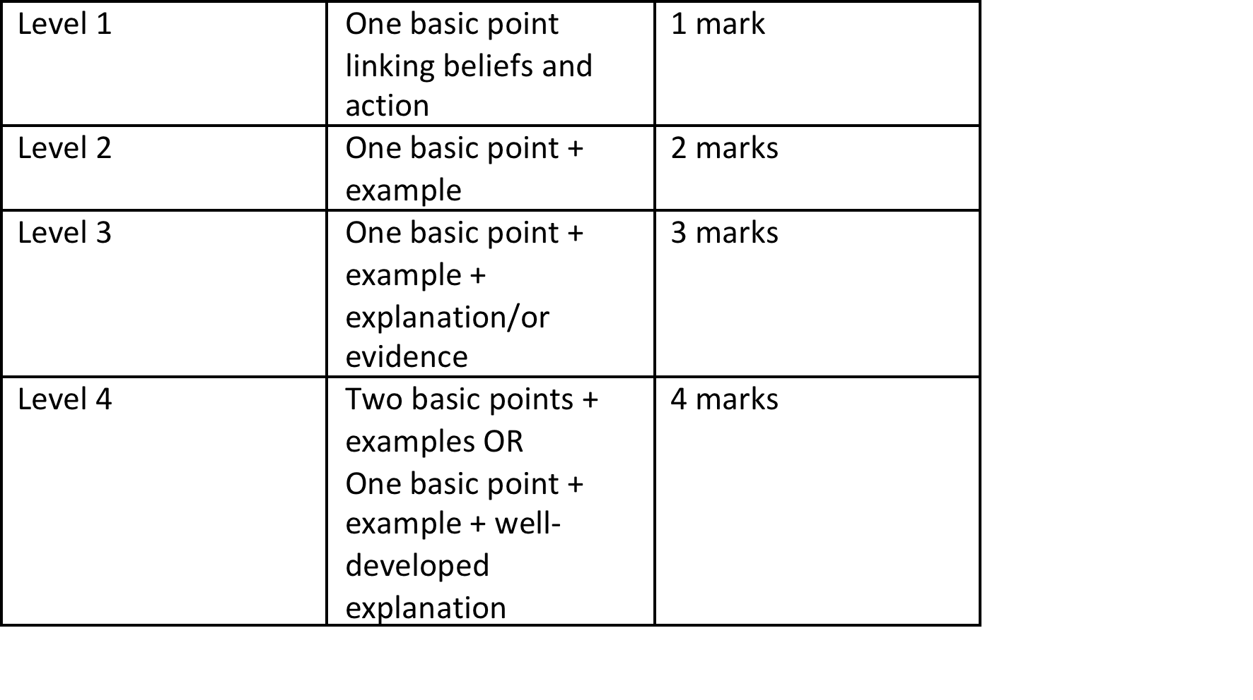
Marking B Questions
Notes:
Make a new slide for your answers

Slide 9
A*
A
To apply religious teachings/vocabulary effectively to improve upon my exam answers
c) ‘Television is not for programs about religion’ Give two reasons why a believer would agree or disagree (4).
A religious believer might agree as some programs bend of truth on what religion is and make fun of certain religions such as The Life of Brian.
Although some programs such as Songs of Praise encourage religion.
1 or 2 = need more explanation
B
To communicate my opinion clearly and use some religious vocabulary in my answers
C
To know key terms for the unit and give my personal opinion about important issues
Notes:
Make a new slide for your answers

Slide 10

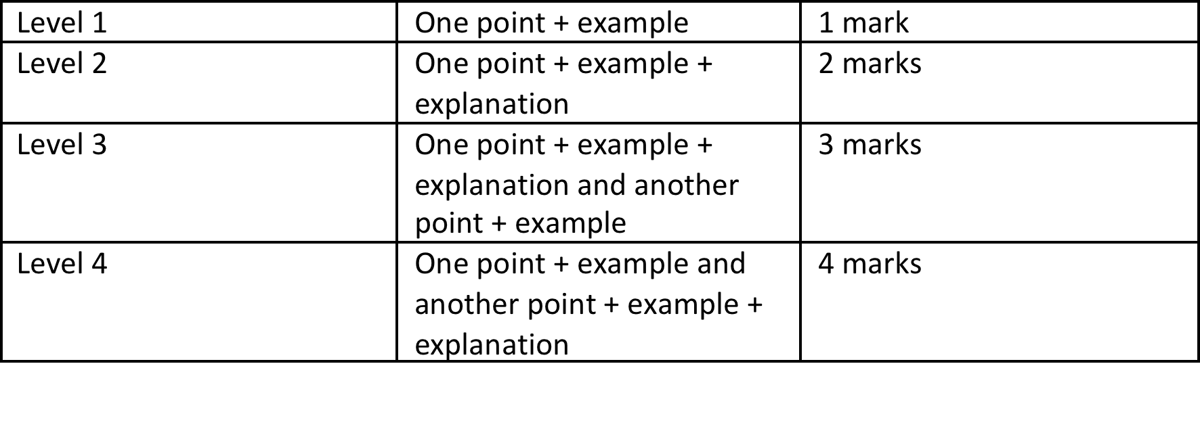
Marking C Questions
Notes:
Make a new slide for your answers

Slide 11
A*
A
To apply religious teachings/vocabulary effectively to improve upon my exam answers
d) Explain from two different religious traditions how a religious building can help believers express faith (6).
Christians like to be part of a community in their place of worship with other people and the cross at the front of the church to help them focus on what they are here to do.
2-3 = needs more development and also you need TWO different traditions
B
To communicate my opinion clearly and use some religious vocabulary in my answers
C
To know key terms for the unit and give my personal opinion about important issues
Notes:
Make a new slide for your answers

Slide 12
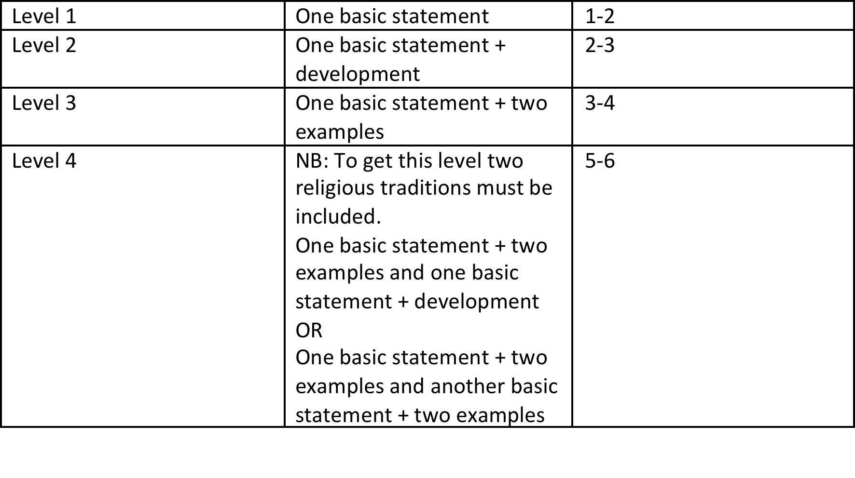
Marking D Questions
Notes:
Make a new slide for your answers

Slide 13


E) I disagree that pilgrimages is important becose religious people still do them. I also think people should be allowed to do what they want.
On the other hand Muslims would also agree becase they visit Meca in their lifetime as part of their religion
So overall I think pilgrimages should continue around the world.
WHAT – is the statement suggesting?
AGREE – Say whether you agree or disagree
WHY – Give really detailed reasons, as many as you can using examples
ON THE OTHER HAND – Explain the attitudes of Christians/Catholics/Muslims towards the statement and what they will think and why!
SO – What do you think overall. Say what you think the best ideas about this are
Notes:
Think about including key terms and religious vocabulary where possible!

Slide 14

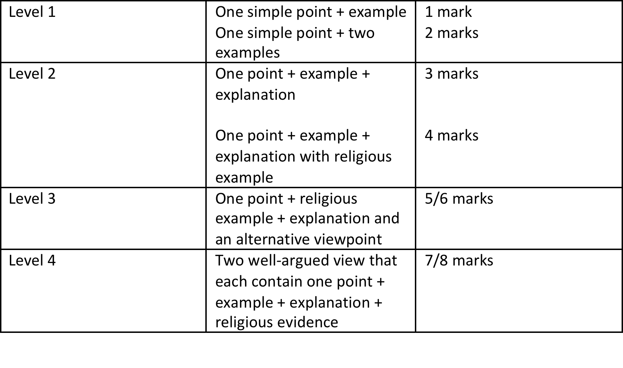
Marking E Questions
Notes:
Think about including key terms and religious vocabulary where possible!

Slide 15

A*
A
To apply religious teachings/vocabulary effectively to improve upon my exam answers
One example is….Another is…
Muslims go on pilgrimage because……..This is known as Hajj. They do this once in their lifestyle. Pilgrimage is important to some believers because….Some Catholics go to Lourdes in France to experience miracles and be part of the religious community.
They might disagree because…….They might agree/disagree because the media……
Christian buildings help believers by………For example……..Also………
A mosque helps Muslims because…for example…..Also………..
B
To communicate my opinion clearly and use some religious vocabulary in my answers
C
To know key terms for the unit and give my personal opinion about important issues
Notes:
Lower ability sheet

